Slide 1

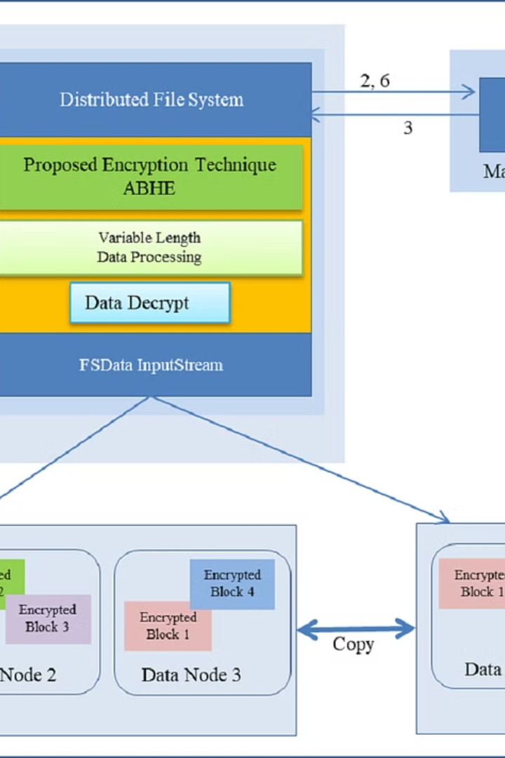


Introduction to Hadoop Storage File System (HDFS)
HDFS is the distributed file system that forms the core of the Apache Hadoop storage infrastructure.
by CHARAN KUMAR

Slide 2
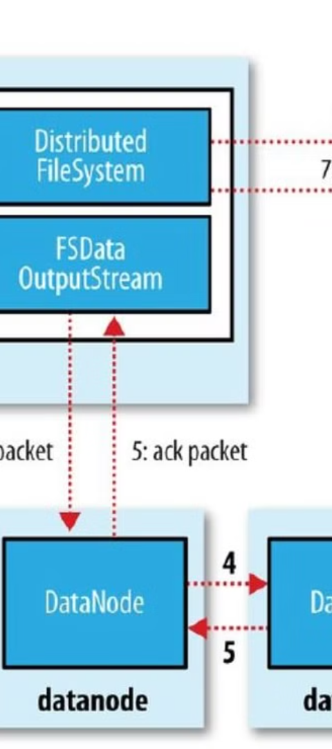
Overview of Directory Structure in HDFS
1
Root Directory
The root directory is the top-level directory in HDFS, denoted by a forward slash (/).
2
Subdirectories
HDFS allows for the creation of subdirectories within the root directory to organize data.
3
Metadata Storage
Metadata is stored separately to provide efficient access and management of directory information.

Slide 3
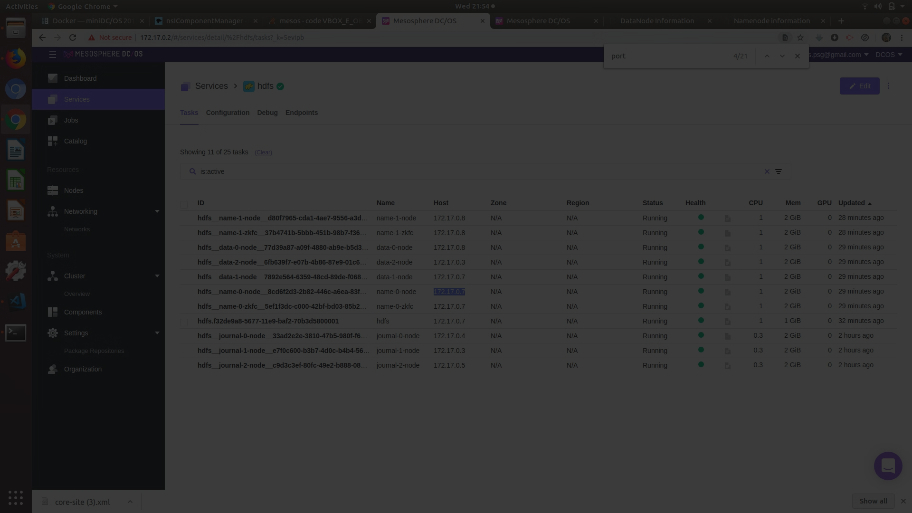
Creating a Directory in HDFS
1
Command Line Interface
2
WebHDFS
Use Hadoop shell commands like mkdir to create directories in HDFS.
WebHDFS REST API enables the creation of directories through HTTP calls.

Slide 4
Managing Directories in HDFS
Copying Directories
Renaming and Deleting
Monitoring and Permissions
Utilize the distcp command for copying directories within or across HDFS clusters.
Procedures for renaming and deleting directories in HDFS to manage data effectively.
Monitor and set permissions to safeguard and control access to directories in HDFS.

Slide 5


Accessing and Navigating Directories in HDFS
Access
Navigation
Seamless access across distributed Hadoop clusters for efficient data retrieval.
Easily navigate through the directory tree structure to locate and access data.

Slide 6
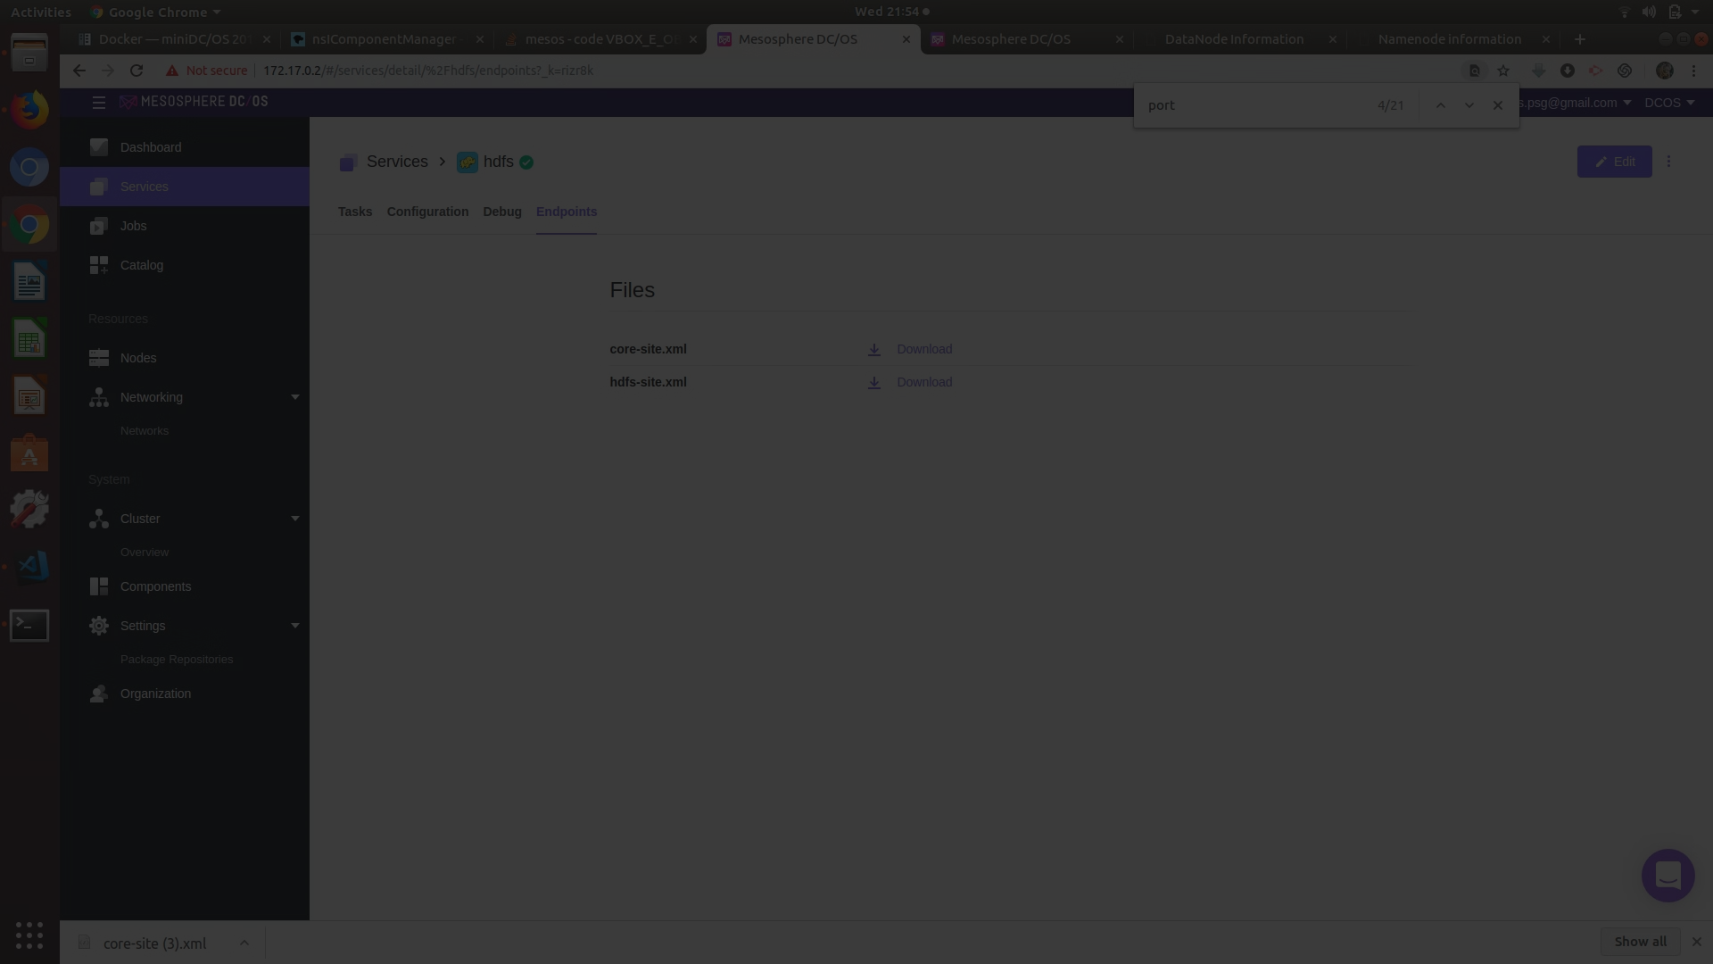



Permissions and Security in HDFS Directories
Role-Based Access
Data Encryption
Audit Logs
Implement role-based access control to ensure secure data interaction.
Apply encryption methodologies to maintain data security within HDFS directories.
Enable audit logs to track and monitor access to HDFS directories for security analysis.

Slide 7
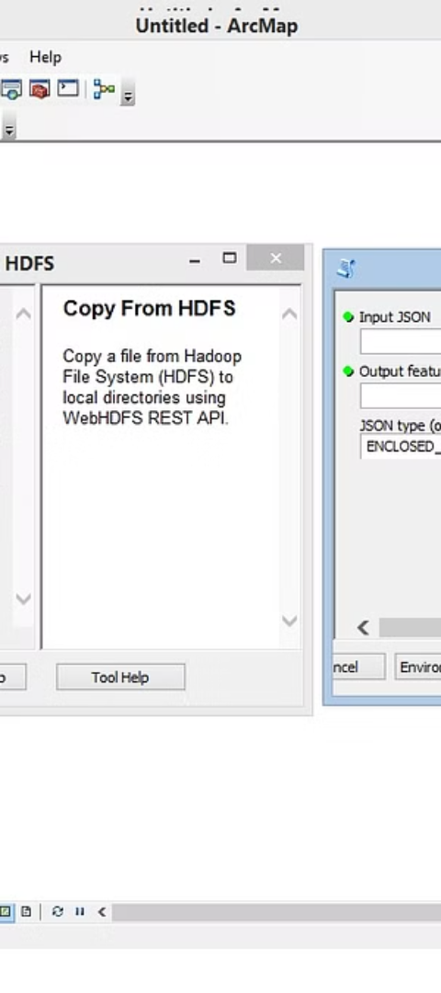
Best Practices for Organizing Data in HDFS Directories
Data Segmentation
Metadata Management
Organize data into separate directories based on specific criteria such as date, type, or source.
Develop a well-structured metadata management approach to categorize and organize data.
Directory Hierarchy
Create a logical and efficient directory hierarchy to streamline data access and administration.

Slide 8
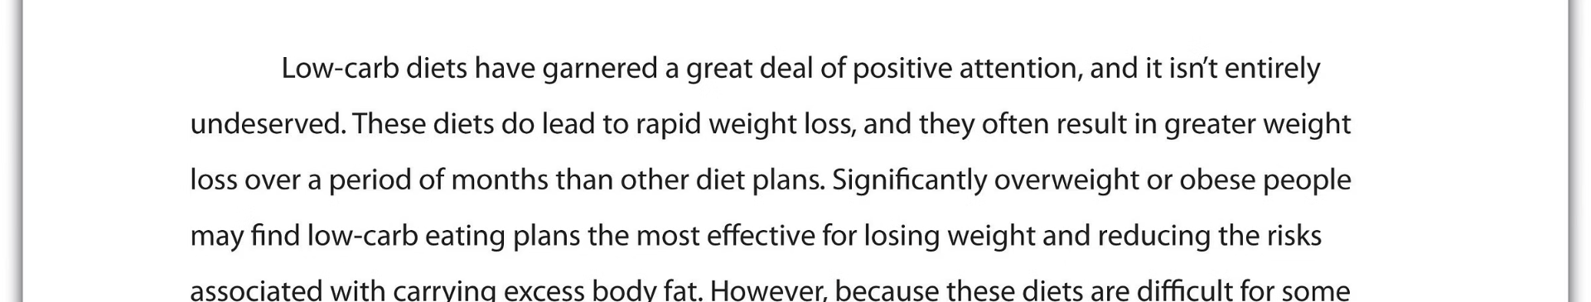
Conclusion and Key Takeaways
Understanding the directory structure and management in HDFS is crucial for effective data storage, access, and security within Hadoop environments.

